Slide 1
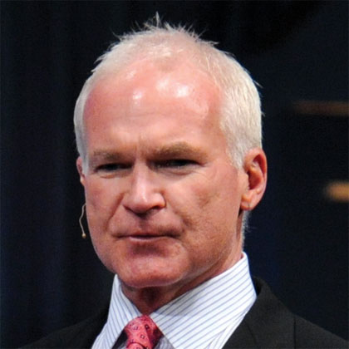
超連鎖™ DNA 打造你的購物年金
UnFranchise™ DNA Creating A Shopping Annuity
Kevin Buckman
特別企劃顧問 Special Projects Consultant

Slide 2
超連鎖™ DNA UnFranchise™ DNA
美安香港最受歡迎的產品就是超連鎖™事業發展系統
「系統為企業家創造可觀的永續收入，同時為全球消費者提供更好的購物方式。」
美安香港的管理業績紅利計劃（MPCP）正是這系統的核心，獎勵每位改變購物內容和方式的超連鎖店主。
Market Hong Kong’s number one selling product is its UnFranchise™ Business Development System
“System for entrepreneurs to create a significant ongoing income, while providing consumers world wide with a better way to shop. ”
At the heart of this system is Market Hong Kong’s Management Performance Compensation Plan (MPCP) that rewards each UnFranchise Owner (UFO) for changing what they shop for and how they shop for it.

Slide 3
超連鎖™ DNA UnFranchise™ DNA
美安香港購物年金由每位超連鎖店主開始創造：
The mhkShopping Annuity begins with each UFO:
將目前每個月所買的居家個人用品換成美安香港品牌的產品。 Change the brands of products they are currently buying for their households each and every month to mhkBranded products.
彩妝品︰M.A.C. 轉成Motives® Change from MAC to Motives®
洗衣用品︰Tide 轉成 SNAP Change from Tide to SNAP
健康補充品︰善存轉成Isotonix Change from Centrum to Isotonix
護膚品︰Clinique轉成Cellular Labs Change from Clinique to Cellular Labs
*超連鎖店主™使用自己的美安香港產品獲得「報酬」（獎勵∕BV）
*UFOs get “PAID” (compensated/BV) for using their own mhk Branded Products

Slide 4
超連鎖™ DNA UnFranchise™ DNA
美安香港購物年金由每位超連鎖店主開始創造：
The mhk Shopping Annuity begins with each UFO (cont’d):
改變每個月或定期的購物方式（例如衣服、電子用品、家電等），不再前往「傳統實體商店」購買，改成透過自己的HK.SHOP.COM網站從網上商店「線上購物」。Change how they buy all other brands of products they buy monthly or periodically (such as clothes, electronics, appliances, etc.) from “brick and mortar” establishments to “click and order” through their own HK.SHOP.COM website from those same establishments.
從HK.SHOP.COM連結至榮華 Access Wing Wah from HK.SHOP.COM/
從HK.SHOP.COM連結至沙嗲王 Access Satay King from HK.SHOP.COM/ ?
從HK.SHOP.COM連結至星晨旅遊 Access Morning Star Travel from HK.SHOP.COM/ ?
***超連鎖店主™透過HK.SHOP.COM消費可獲得「報酬」（IBV∕現金回贈），而直接前往榮華則無此類好處)UFOs get “PAID” (IBV and Cashback) to purchase through HK.SHOP.COM/kcb vs. going direct to 榮華

Slide 5
超連鎖™ DNA UnFranchise™ DNA
找出10至15名顧客來改變其消費習慣，以符合步驟1與2的要求，與他們建立夥伴關係及創造終身價值。 Identifying 10-15 individuals to do the exact same thing and build relationships to create lifetime value in customers or future business partners (UFOs).
*顧客購買美安品牌產品可以賺取現金回贈Customers get “PAID” (cashback) for purchasing mhkBranded products.
*顧客到HK.SHOP.COM購物可以賺取現金回贈Customers get “PAID” (cashback) for purchasing through HK.SHOP.COM/kcb.
* 顧客推薦其他顧客到HK.SHOP.COM購物可以賺取現金回贈Customers get “PAID” (cashback) for referring Customers to HK.SHOP.COM/kcb to do the same.
鎖定最少2名潛在夥伴，幫助他們依循上述方式，改變消費習慣，改善他們自己的財務狀況。 Identifying 2 or more individuals committed to improving their financial situation by performing Steps 1-4!

Slide 6
超連鎖™ DNA UnFranchise™ DNA
購物年金可以創造永續的BV和IBV收入，而這正正就是業績紅利計劃的精髓。
每位超連鎖店主要以成為「購物顧問」為目標。讓自己和顧客高效率地購買生活用品！
The result is the creation of a never-ending flow of BV and IBV, which is the lifeblood of the MPCP.
Each UFO’s objective is to become a “Shop Consultant”. Making the shopping experience for their household and the households of their customers as efficient as possible!

Slide 7
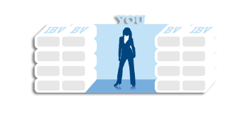
超連鎖™ DNA UnFranchise™ DNA
C -
- C
C -
- C
C -
- C
C -
- C
C -
- C

Slide 8
超連鎖™ DNA UnFranchise™ DNA
C -
- C
C -
- C
C -
- C
C -
- C
C -
- C
C -
- C
C -
- C
C -
- C
C -
- C
C -
- C
C -
- C
C -
- C
C -
- C
C -
- C
C -
- C
C -
- C
C -
- C
C -
- C
- C
C -
- C
C -
- C
C -
- C
- C
C -
- C
C -
- C
C -
- C
- C
C -
- C
C -
- C
C -
- C
- C
C -
- C
C -
- C
C -
- C
- C

Slide 9
超連鎖™ DNA UnFranchise™ DNA
1200 BV
1200 BV
BV
BV
BV
BV
BV
BV
BV
Notes:
9
9

Slide 10
打造你的購物年金Creating A Shopping Annuity
從居家用品開始評估：Starts with Household Assessment:
檢視（一一盤點）每月及每季的消費項目。Surveying (taking inventory) of what you spend or buy monthly and quarterly.
看看有多少東西可以能讓你累積購物年金，達至轉消費為收入！Discover how many things you could use to fund your shopping annuity and simply convert SPENDING INTO EARNING!
建立美安香港購物清單Create mhk Home Shopping List (HSL)
建立「我的清單」Create a My List
從你開始做起，鼓勵每位夥伴也這麼做，然後讓每位顧客複製同樣的過程。Starts with You, then conduct with each Business Partner and duplicate with each Customer

Slide 11
UnFranchise™ DNA Creating A Shopping Annuity
超連鎖™ DNA 打造你的購物年金

